Slide 1
SKY Hackathon----教NANO认路标
NVIDIA 开发者社区 何琨

Slide 2
课程目录
课程介绍
NVIDIA Transfer Learning Toolkit介绍
Transfer Learning Toolkit代码实践
TensorRT介绍
利用TLT训练出来的模型部署推理引擎
Notes:
Deep Learning is fueling the growth of applications in smart cities. Developers are increasingly using Deep Learning for computer vision applications. Public repositories and model zoos have popped up.
Using pre trained models is a popular approach but these models are not the most accurate
Also they have not been optimized for GPU utilization
One of the biggest challenges is the memory footprint. Large data produces large models and reducing the size of model so that it can fit on a smaller edge device is not just trending but imperative.
Having optimized pre-trained deep learning models and a toolkit to tweak those models is a desirable solution

Slide 3
课程介绍
本次课程利用NVIDIA Transfer Learning Toolkit（后面使用TLT作为简称）训练模型，训练模型以及优化模型部分请参阅TLT部分
本次课程针对有一定编程基础的开发者，需要对Python，深度学习，opencv等内容有一定了解
本次课程目标是利用NVIDIA TensorRT加速SSD-Mobilenet V2的交通标志检测模型，实现在图片，视频或者摄像头画面中检测出交通标志，并判断是哪一类
本次课程提供最基础的开发流程，以及相关工具和框架的使用方法，鼓励各位开发者在本教程的基础上做更多更好的优化。
本次课程实验作者需要以下实验环境:
硬件平台： NVIDIA Jetson NANO
软件平台：
NVIDIA Jetpack 4.4
Ubuntu 18.04 L4T
Python 3.6.9
TensorRT 7.1
CUDA 10.2
Tensorflow 1.15
NVIDIA Transfer Learning Toolkit 2.0
Numpy 1.16.1
Opencv 4.1.1
Notes:
Deep Learning is fueling the growth of applications in smart cities. Developers are increasingly using Deep Learning for computer vision applications. Public repositories and model zoos have popped up.
Using pre trained models is a popular approach but these models are not the most accurate
Also they have not been optimized for GPU utilization
One of the biggest challenges is the memory footprint. Large data produces large models and reducing the size of model so that it can fit on a smaller edge device is not just trending but imperative.
Having optimized pre-trained deep learning models and a toolkit to tweak those models is a desirable solution

Slide 4
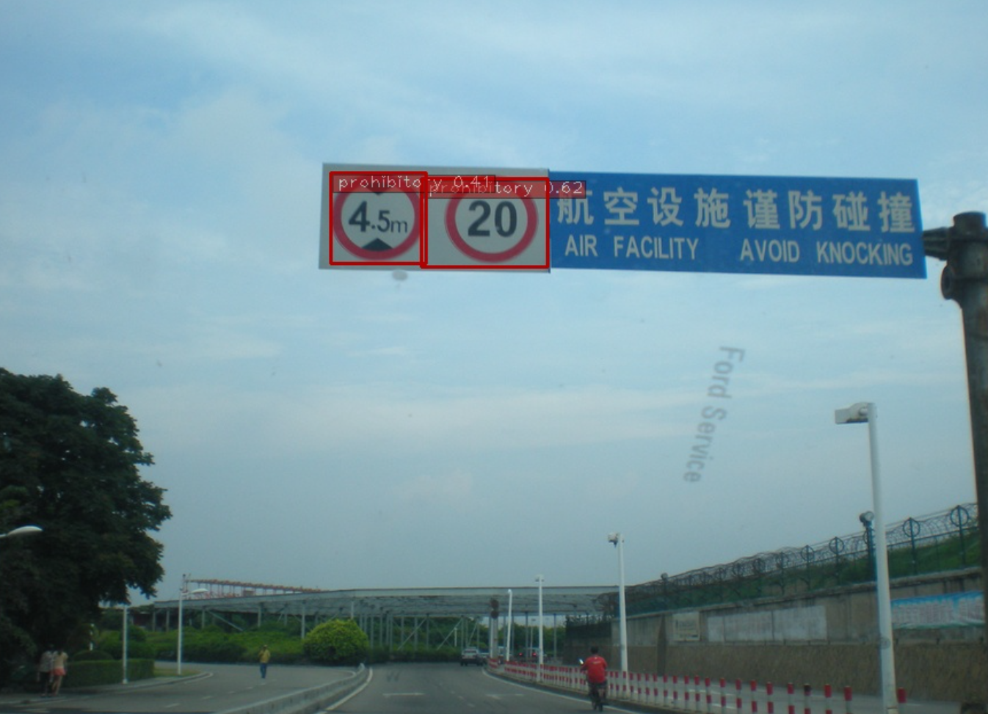
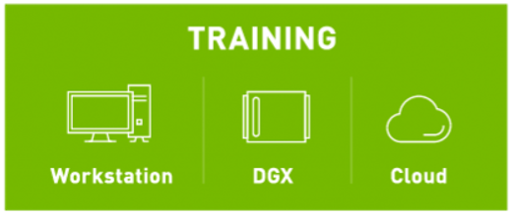
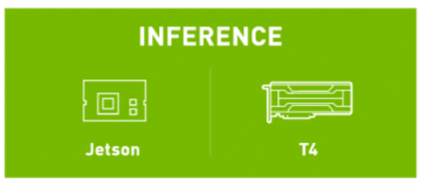
课程介绍
Dataset Labeling etc
Notes:
Deep Learning is fueling the growth of applications in smart cities. Developers are increasingly using Deep Learning for computer vision applications. Public repositories and model zoos have popped up.
Using pre trained models is a popular approach but these models are not the most accurate
Also they have not been optimized for GPU utilization
One of the biggest challenges is the memory footprint. Large data produces large models and reducing the size of model so that it can fit on a smaller edge device is not just trending but imperative.
Having optimized pre-trained deep learning models and a toolkit to tweak those models is a desirable solution

Slide 5

课程介绍
本次实验将道路标志分为三类，分别是禁止类标识(prohibitory),指示类标识(mandatory)和警告类标识(warning)
prohibitory
mandatory
warning
Notes:
Deep Learning is fueling the growth of applications in smart cities. Developers are increasingly using Deep Learning for computer vision applications. Public repositories and model zoos have popped up.
Using pre trained models is a popular approach but these models are not the most accurate
Also they have not been optimized for GPU utilization
One of the biggest challenges is the memory footprint. Large data produces large models and reducing the size of model so that it can fit on a smaller edge device is not just trending but imperative.
Having optimized pre-trained deep learning models and a toolkit to tweak those models is a desirable solution

Slide 6
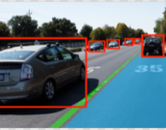
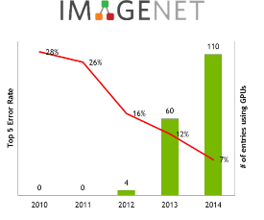









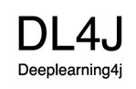









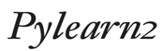



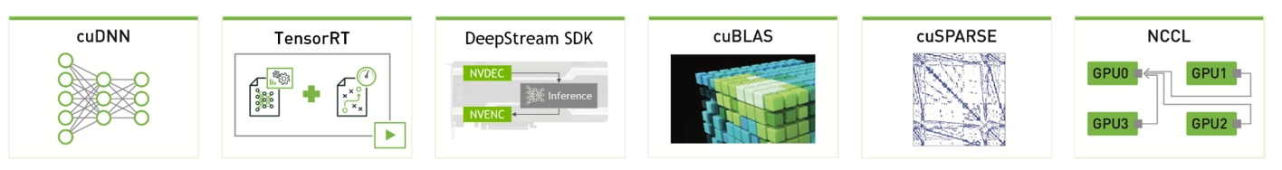
Powering the Deep Learning Ecosystem
COMPUTER VISION
SPEECH & AUDIO
NATURAL LANGUAGE PROCESSING
OBJECT DETECTION
IMAGE CLASSIFICATION
VOICE RECOGNITION
LANGUAGE TRANSLATION
RECOMMENDATION ENGINES
SENTIMENT ANALYSIS
DEEP LEARNING FRAMEWORKS
Mocha.jl
NVIDIA DEEP LEARNING SDK
developer.nvidia.com/deep-learning-software

Slide 7
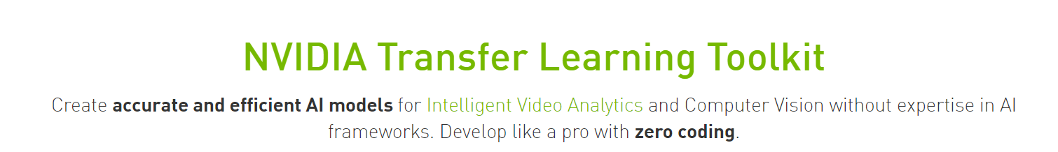
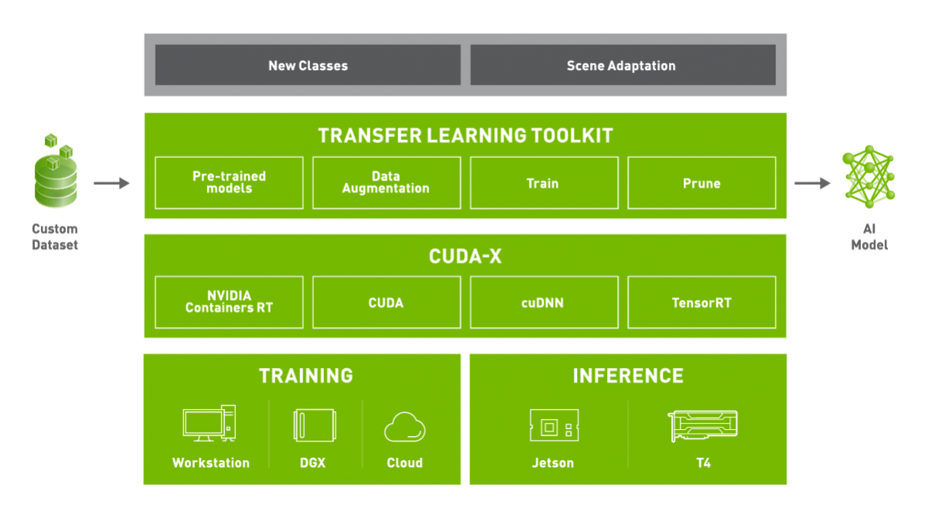

Slide 8
Deep Learning Workflow Management
Deep Learning Challenges
NVIDIA Deep Learning Solution
Third Party Pre-Trained Models
Lack accuracy
Use case limitations
Model size limitations
Unoptimized for GPUs
Transfer Learning Toolkit
GPU accelerated
pre trained models
Incremental Training
Pruning
Deep Learning Training
Compute Resources
Time spent training from scratch
Learning DL frameworks
Easy to use
Abstraction from
learning DL frameworks
Deep Learning Inference
Unclear workflows for production ready models
Complex application pipeline
DeepStream SDK
Faster intelligent insights
Track inference
End to end- easy AI deployment
Notes:
Deep Learning is fueling the growth of applications in smart cities. Developers are increasingly using Deep Learning for computer vision applications. Public repositories and model zoos have popped up.
Using pre trained models is a popular approach but these models are not the most accurate
Also they have not been optimized for GPU utilization
One of the biggest challenges is the memory footprint. Large data produces large models and reducing the size of model so that it can fit on a smaller edge device is not just trending but imperative.
Having optimized pre-trained deep learning models and a toolkit to tweak those models is a desirable solution

Slide 9
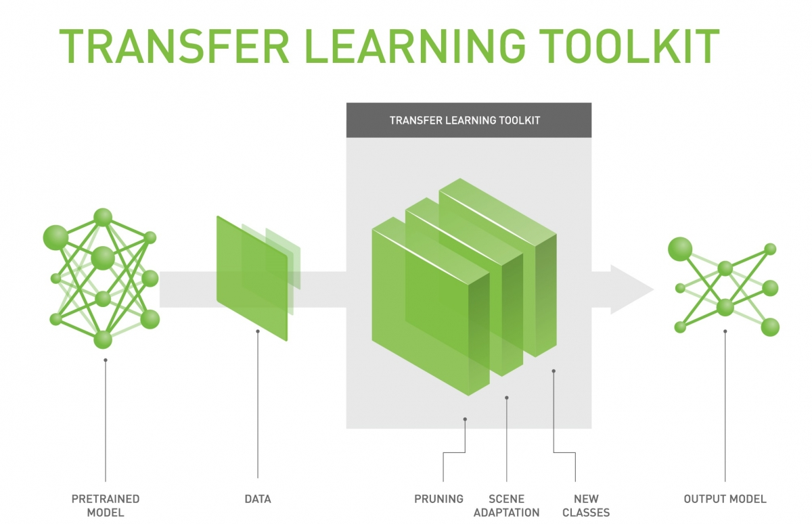
NVIDIA Transfer learning Toolkit
Develop like a pro with zero coding.
Transfer Learning Toolkit是一个基于python的工具包，它使开发人员能够利用NVIDIA预先训练的模型，并为开发人员提供一系列的工具，使流行的网络架构适应他们自己的数据，并且能够训练、调整、修剪和导出模型以进行部署。它还拥有简单的接口和抽象API，提高了深度学习训练工作流的效率。
GPU优化的预训练模型，可用于计算机视觉任务
轻松修改配置文件以添加新类并使用自定义数据重新训练模型
在异构的多GPU环境中执行模型调整和重新训练
使用修剪功能缩小模型尺寸
模型导出API，可在具有NVIDIA Tesla和Jetson产品的NVIDIA DeepStream SDK上部署

Slide 10
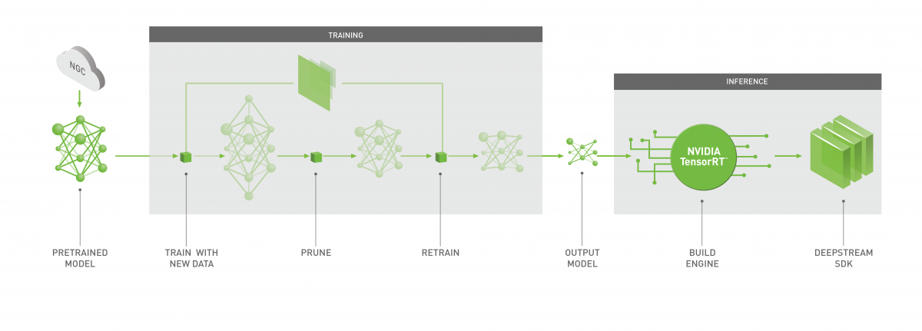
NVIDIA Transfer learning Toolkit
为应用在计算机视觉领域的深度学习工作流程，提供了全方位的便利工具

Slide 11
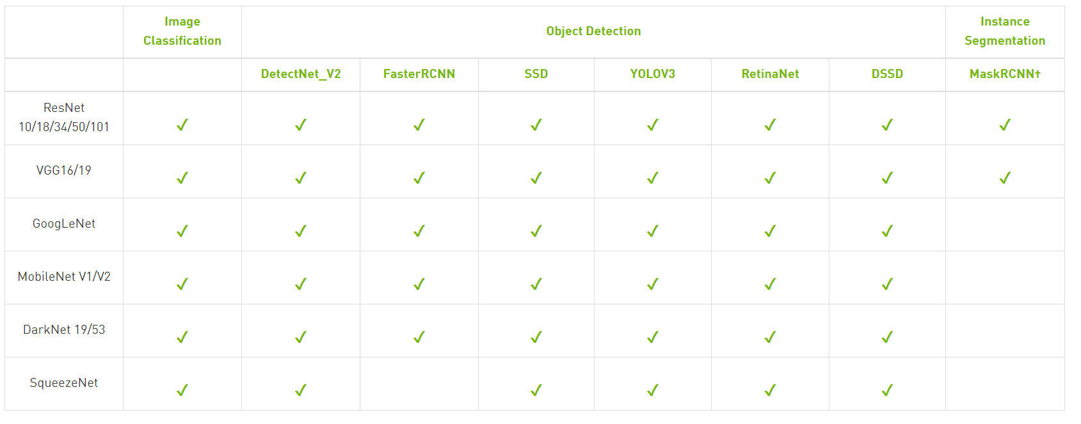
NVIDIA Transfer learning Toolkit
在指定的公共数据集上训练的图像分类和目标检测模型，可与Transfer Learning Toolkit一起使用。

Slide 12
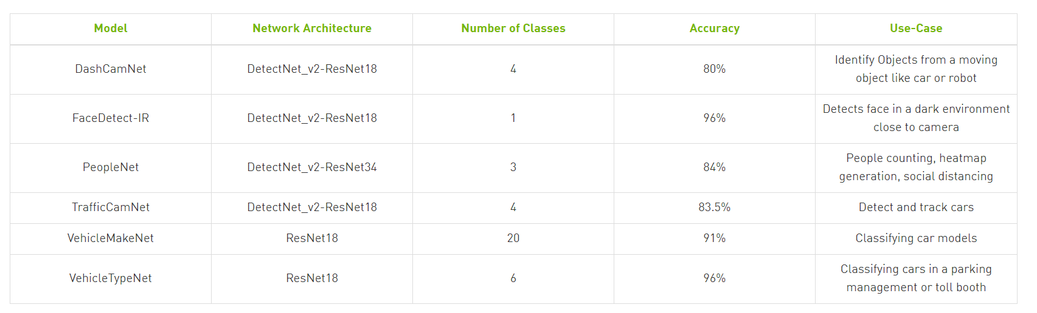
NVIDIA Transfer learning Toolkit
在指定的公共数据集上训练的图像分类和目标检测模型，可与Transfer Learning Toolkit一起使用。

Slide 13
在服务器上部署Transfer Learning Toolkit
Hardware Requirements
Minimum
4 GB system RAM
4 GB of GPU RAM
Single core CPU
1 GPU
50 GB of HDD space
Recommended
32 GB system RAM
32 GB of GPU RAM
8 core CPU
4 GPUs
100 GB of SSD space
Software Requirements
Ubuntu 18.04 LTS/16.04 LTS
NVIDIA GPU Cloud account and API key - https://ngc.nvidia.com/
docker-ce installed, https://docs.docker.com/install/linux/docker-ce/ubuntu/
nvidia-docker2 installed, instructions: https://github.com/nvidia/nvidia-docker/wiki/Installation-(version-2.0)
NVIDIA GPU driver v410.xx or above
Note: DeepStream 4.0 - NVIDIA SDK inference https://developer.nvidia.com/deepstream-sdk is recommended.

Slide 14
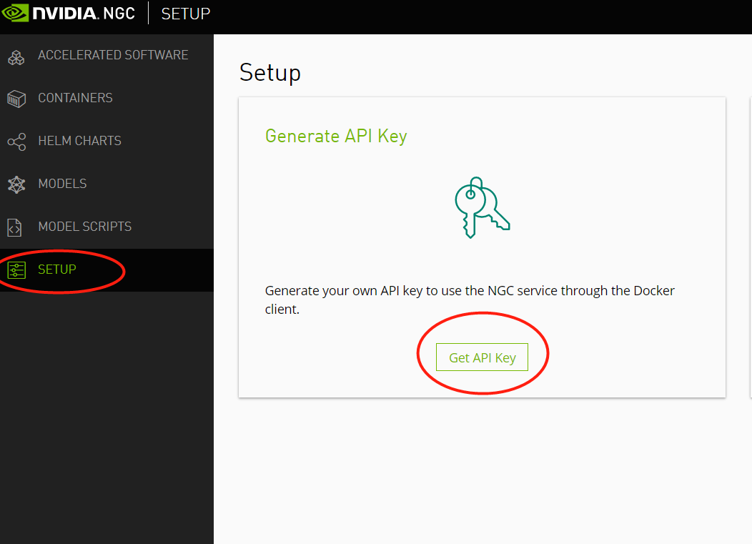
在服务器上部署Transfer Learning Toolkit

Slide 15
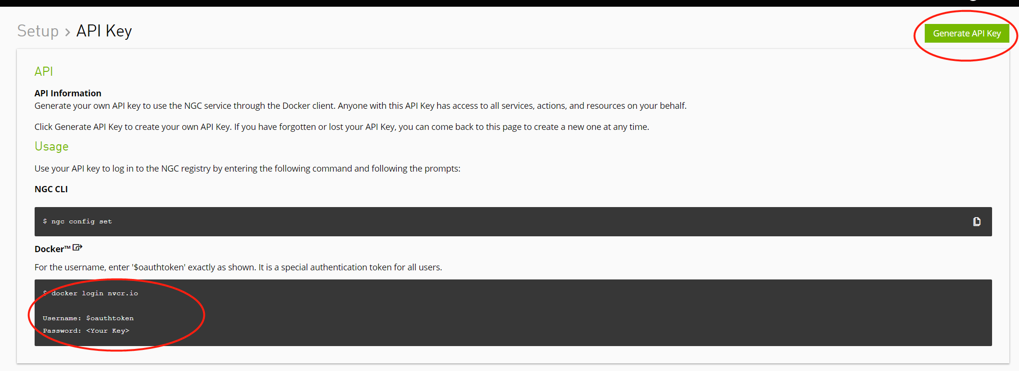
在服务器上部署Transfer Learning Toolkit

Slide 16
Transfer Learning Toolkit的工作流程
Model
Selection
Server
Jetson
Pre Trained Model Importer
预训练模型
Dataset Labeling etc
Training & validation loops
Trainer
Pruner
Exporter
Convert Model
(TensorRT)
准备数据集
设置训练参数
训练模型
模型剪枝
导出模型
转换模型格式
Stabilize / fine-tune
DeepStream Plugins
Metrics
评估模型
DeepStream graph
Results & Visualizations

Slide 17
Transfer Learning Toolkit的工作流程
设置环境变量
准备数据集和预训练模型 1.1 将数据集转换成KITTI格式并生成TFrecord文件 1.2 下载预训练模型
设置训练参数
利用NVIDIA Transfer Learning Toolkit训练模型
评估模型
模型剪枝
重新训练剪枝后的模型
评估重新训练的模型
可视化推理过程
模型的导出和部署
确认导出模型

Slide 18
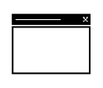

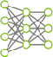

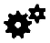

TensorRT Workflow
Input
●
Output
●
Pre-trained FP32 model and network
Optimized execution engine on GPU for deployment
Serialized a PLAN can be reloaded from the disk into the TensorRT runtime. There is no need to perform the optimization step again.
NEURAL NETWORK
OPTIMIZATION ENGINE
PLAN
EXECUTION ENGINE

Slide 19
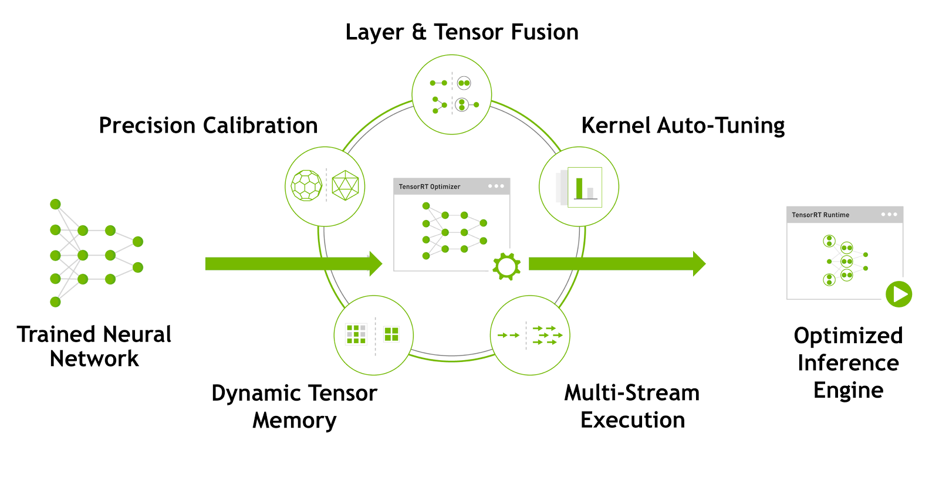
TensorRT

Slide 20
总结
NVIDIA Transfer Learning Toolkit为深度学习训练部署流程提供了完整的工具链
把训练和剪裁好的模型部署在边缘设备(Jetson 平台)上时，需要在边缘设备上转换成TRT的格式
使用TLT导出模型时要注意参数的设置，特别是数据精度以及Tensor维度

Slide 21
Thank you

